Slide 1
Maker’s university – by intel’s makers community class 5 – advanced topics
Gil Tal.
Feb 2020

Slide 3
Class 5 agenda:
Multi CPU and Tasks (threads)
Cache coherency
Interrupts
Level and edge triggered
Critical code (Mutex)
CPU power saving modes
Deep sleep
Hibernation

Slide 4

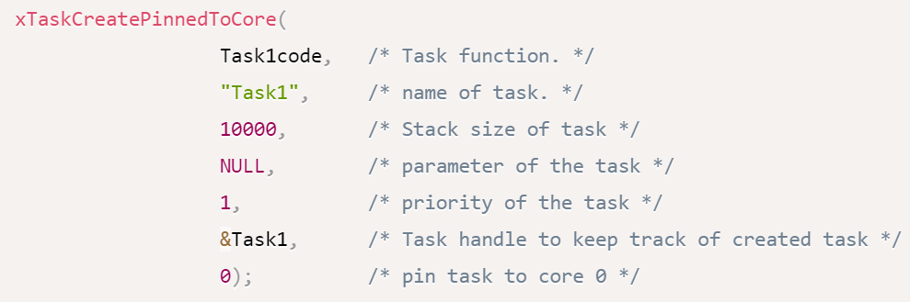
Multi CPU
As said before – ESP32 has two CPU cores running in parallel
Setup and loop run on CPU1
The two CPUs can execute code simultaneously
ESP32 modules are running FreeRTOS which support tasks (Threads)
Tasks support:
Suspend\Resume
Delay (in CPU ticks)
Deleting, even it self!!
Priority with dynamic changing
When code is finished task is dead – Use while if needed

Slide 5
Multi CPU – task’s main functions
TaskHandle_t TH;
xTaskCreate(task function, ”task name”, stack size, parameter for task, priority, task handle)
xTaskCreatePinnedToCore(task function, ”task name”, stack size, parameter for task, priority, task handle, CPU number)
vTaskDelay(TaskHandle_t TH)
vTaskDelete(TaskHandle_t TH)
vTaskPrioritySet(TaskHandle_t TH)
vTaskPriorityGet(TaskHandle_t TH)
vTaskSuspend(TaskHandle_t TH)
vTaskResume(TaskHandle_t TH)

Slide 6
Cache coherency
Cache memory
A small memory within the CPU that stores data so that future requests for that data can be served faster
Coherency
I/O cache coherency
MESI (Sync CPUs caches)
Modified
Exclusive
Shared
Invalid

Slide 7
interrupts
What is an interrupt? Who needs it?
Signals sent to the CPU by:
I/Os (External device connected to our I/Os)
Devices – upon status change
Internal units within the SoC (Timers for example)
When the CPU receives this signal:
Stops executing current code
Move to execute a dedicated code (ISR – Interrupt Service Routine)
When done, it continues from the point it left
Can be edge or level triggered
Interrupt service routine should be as small as possible
ISR and our code can communicate via global variables

Slide 8
Interrupts – What for?
Perform routine tasks (using a timer as a trigger)
Handle a device or I/O upon:
Data reception
Status change which needs our attention
Make more efficient code
At times saves the need to address a device or read a register
Save power
Run code in the back ground (example on next slide)

Slide 9

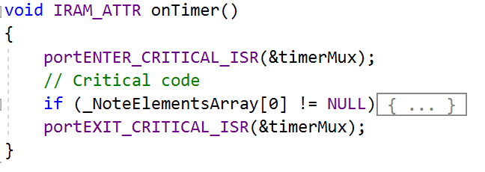
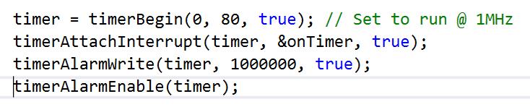
Interrupts – sound stream playing example
Each node contains the note and duration
In the ISR we set the note to play and set the timer to trigger an interrupt after duration
This way stream is playing in the background
Any other way can be very complicated
Note: C5
Duration: 250ms
Note: B4
Duration: 250ms
Note: None
Duration: 1000ms
Note: F3
Duration: 150ms

Slide 10

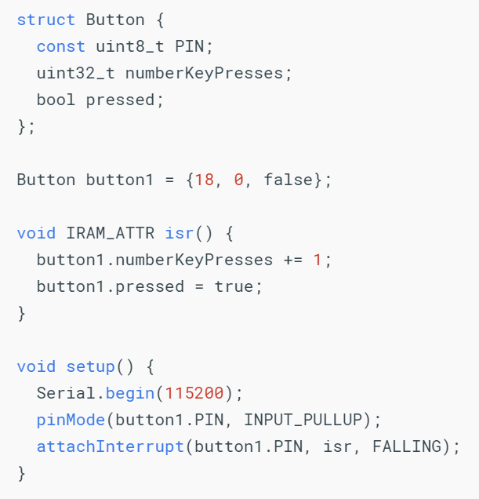
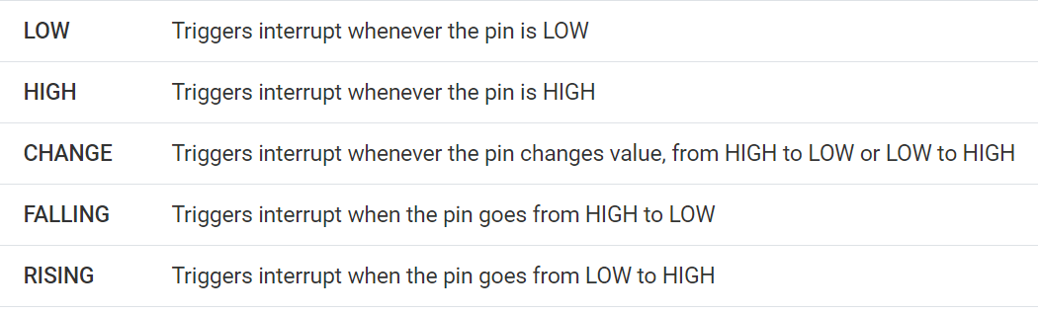
Interrupts – from an I/O pin

Slide 11
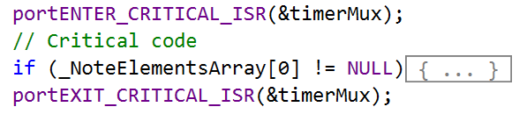
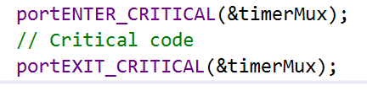
Multi CPU – critical section code
What happens if the two CPUs or ISR and main code:
Share a parameter
Access same device
Need to protect access from other CPUs or ISR while in use
We use portMUX_TYPE

Slide 12
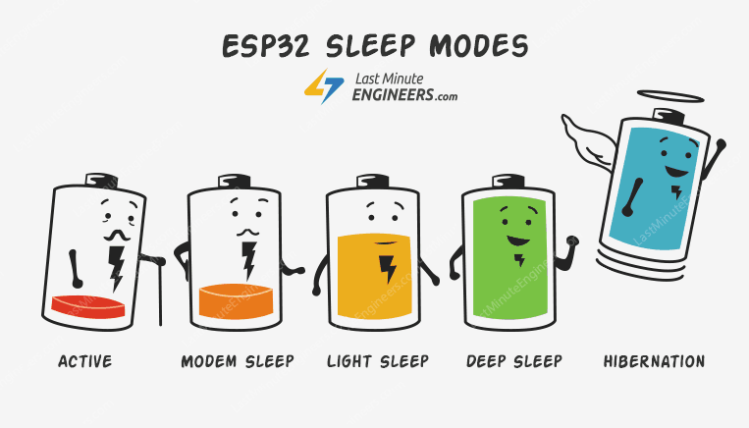
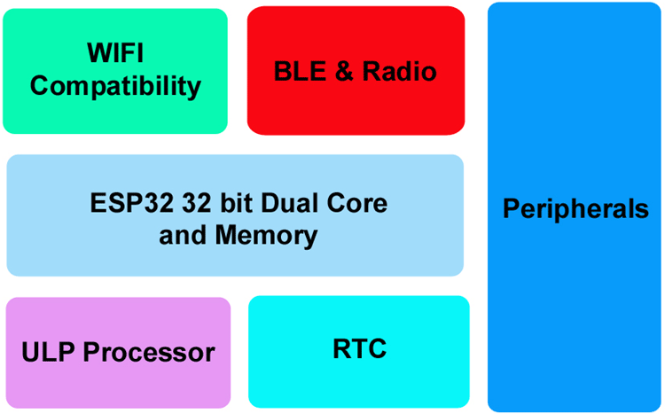
ESP32 power modes
Power Mode | Active | Modem Sleep | Light Sleep | Deep Sleep | Hibernation
CPU | ON | ON | PAUSE | OFF | OFF
Bluetooth/Wi-Fi/Radio | ON | OFF | OFF | OFF | OFF
RTC & Peripherals | ON | ON | ON | ON | Partially on
ULP | ON | ON | ON | ON/OFF | OFF
Current Consumption | 95-240 mA | 2-50 mA | 0.8 mA | 10-150 uA | 5 uA

Slide 13



Deep sleep
6 Seconds sleep
Enable wakeup from external pin
Can run for few years with 18650 battery!
Great when coupled with digital ink display

